Slide 1

Data Science in health & Medicine
Booz Allen Hamilton internal
Example applications of data science in the health space
Innovation center, Washington, D.C.
January 2018

Slide 2


agenda
Quick review of types of data science
Data science for medicine
This Kaggle competition- Detecting cell nuclei

Slide 3
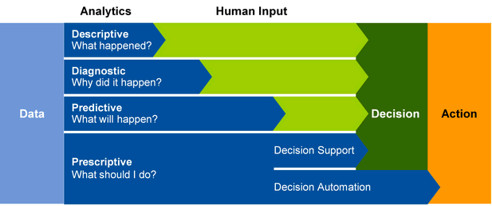
Types of data Analytics

Slide 4
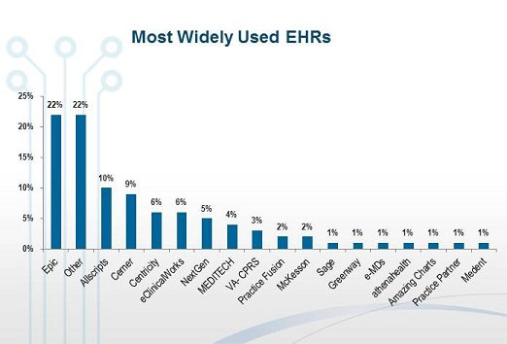
Descriptive analytics in Health & Medicine
Electronic Health Records- EHRs
Huge need for big data infrastructure
Data security and data fusion problems
Can help individuals and with population
health management.
Answer questions like:
How many patients are living with diabetes?
How many acquired an infection at one hospital compared to another?

Slide 5

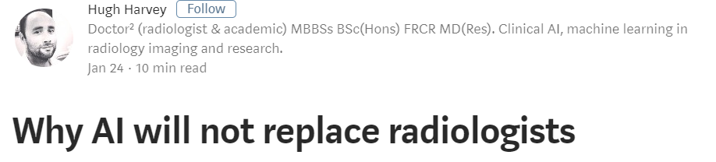
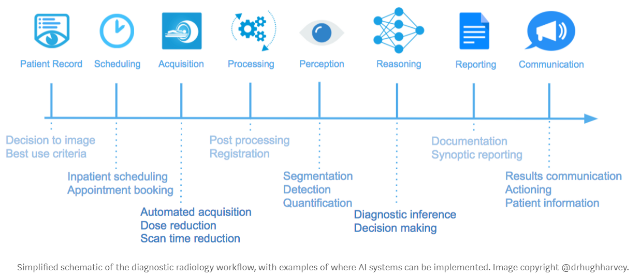
DIAGNOSTIC analytics in Health & Medicine
Lots of effort on Image Processing
Train models to make diagnoses from X-rays, CT scans, MRIs, ultrasounds and PET scans

Slide 6
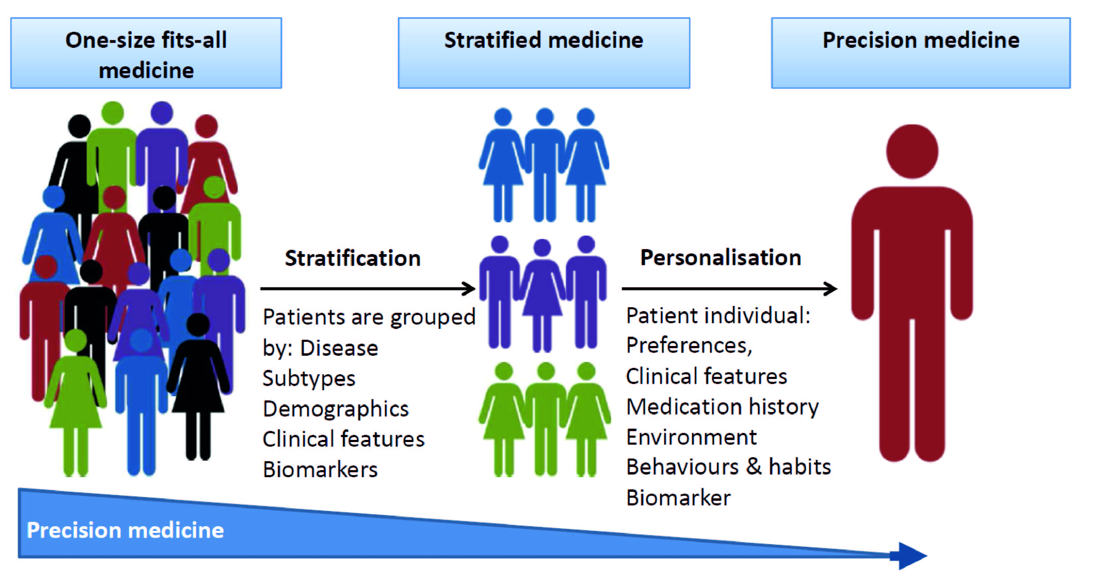
Precision medicine
Identify which approached will be effective for patients based on genetic, environmental, and lifestyle factors
Needs “megacommunity” to pool all kinds of data: genomic, biospecimen-derived, survey and demographic data, clinical and insurance-claims, mobile, wearables, implant data…’
Use data science to find “hidden” correlations, predictors, etc.
Still in trying to set up “data lakes” and cooperation between data sources
Challenges 1: so many types of data- molecular, semantic, images
Challenge 2: so few standardized outcome measures

Slide 7
Side note: How to describe your data science projects
Objective & Motivation- we’ll go over today
Role- clarify your responsibilities
Data- approximate dataset size skew, how to store, extract, clean
Models- specify models and statistical techniques, programming languages and libraries
Code- put it on your own github too!
Results- outcome with numerical impact/significance
Obstacles- and how you overcame them

Slide 8
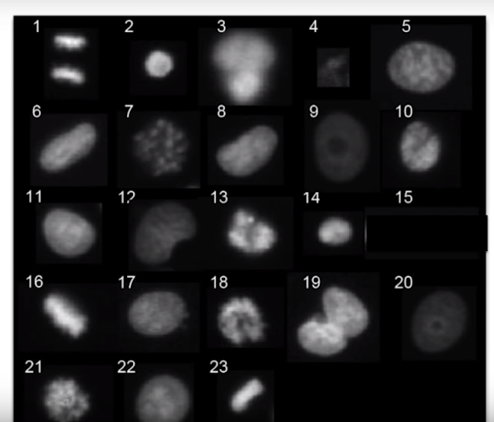
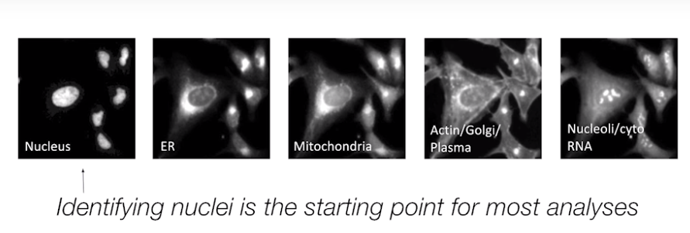
Kaggle: spot Nuclei. Speed cures.
Fast and accurate detection of nuclei enhances drug development -> advances medical treatment -> improves quality of life
Bottleneck for finding nuclei in microscopy images
Robots exist to apply drugs and capture images, but automated counting is not as robust as scientists need

Slide 9
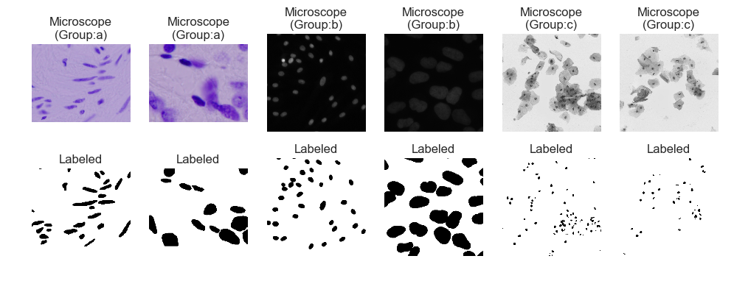
Lots of different types of cells and microscopy conditions

Slide 10
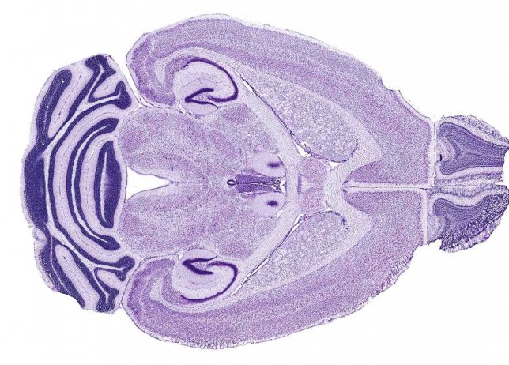
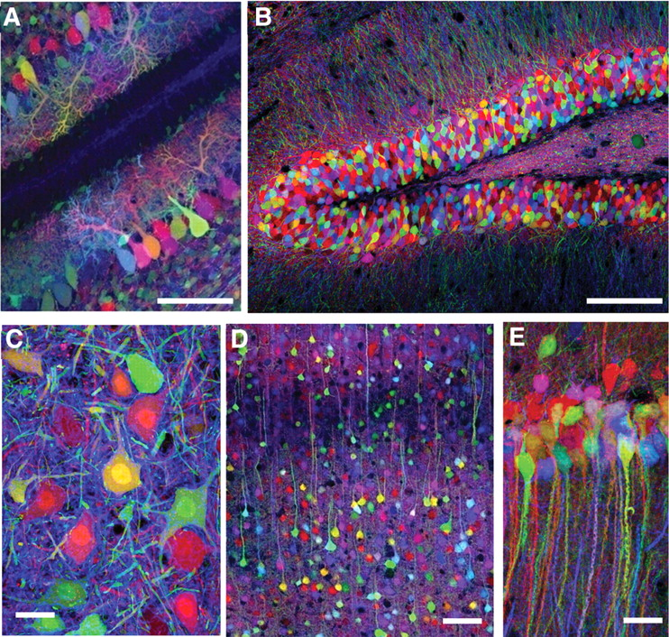
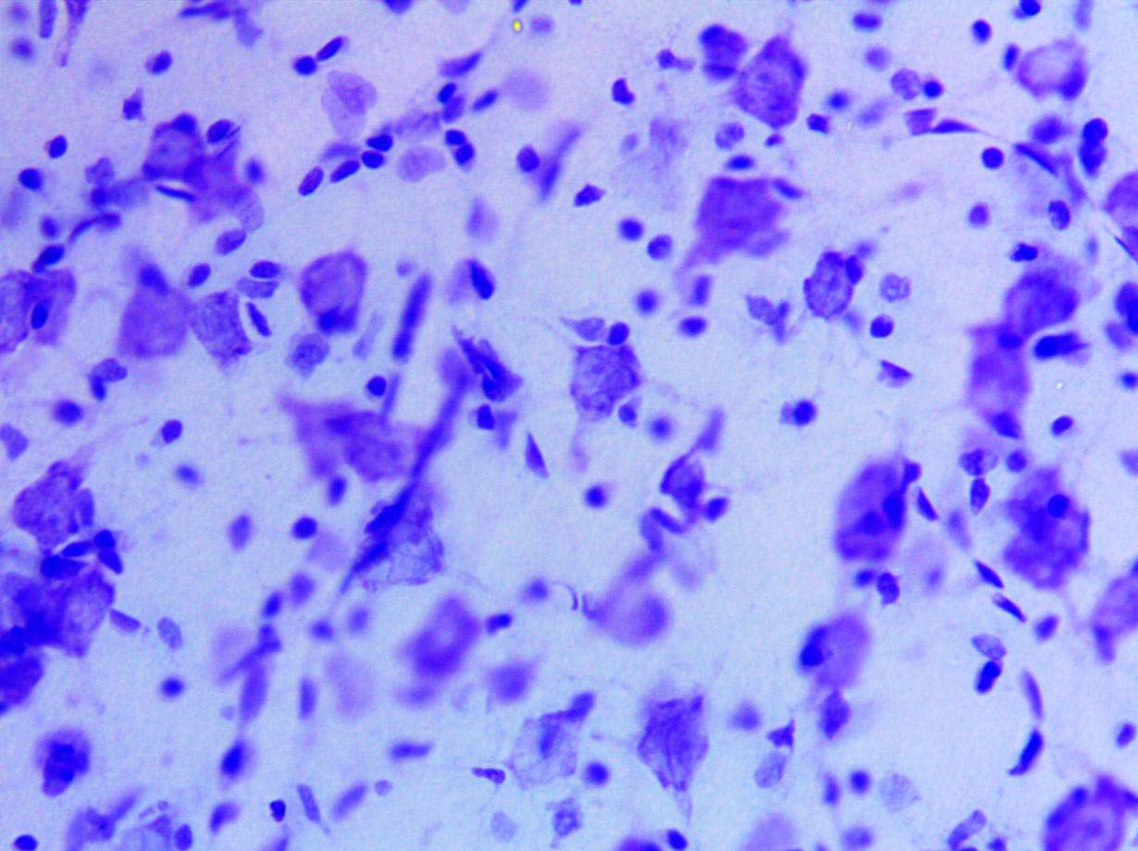
If you like microscopy

